Slide 1

Premier League 2020-21
Team home runs only:
Andrew Cowan, Daniel Fernandez, Kadien Peart, Rashmi Rekha

Slide 2
Project Scope
Our project was based around a Kaggle database containing statistics for the 2020-21 Premier League season
This database was the best because of the depth and breadth of statistics
We chose to load the full table in our PostgreSQL database and pare down the data called there to provide for our web diagrams

Slide 3
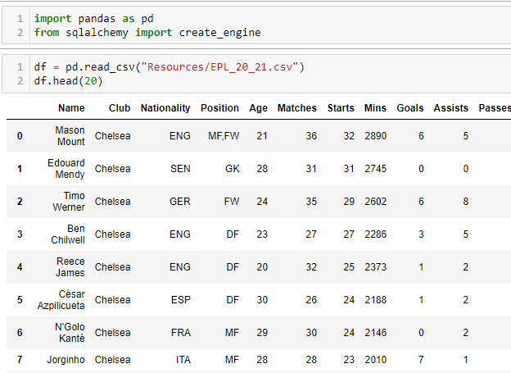
Technical Approach – Extract
Loading the CSV into a Jupyter notebook for cleanup and transformation

Slide 4


Technical Approach - Transform
Querying DataFrame to pull out category leaders

Slide 5
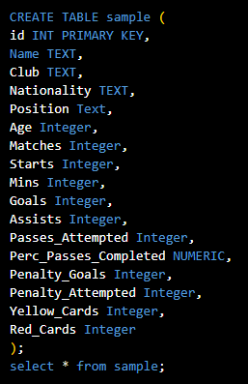
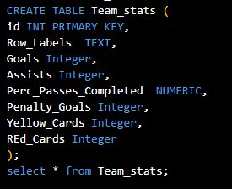
Technical Approach - Load
Creating PostgreSQL database

Slide 6
Technical Approach - Flask
Flask application to load data into the website

Slide 7
Technical Approach - HTML
HTML structure

Slide 8
Technical Approach - JavaScript
JavaScript Libraries used: Leaflet, D3,

Slide 9
Technical Difficulties
Flask to JavaScript connection was complicated and complex
Generating Selectors for Top 10 tables and player comparisons was difficult at times

Slide 10
Final Product
Our working page

